Slide 1

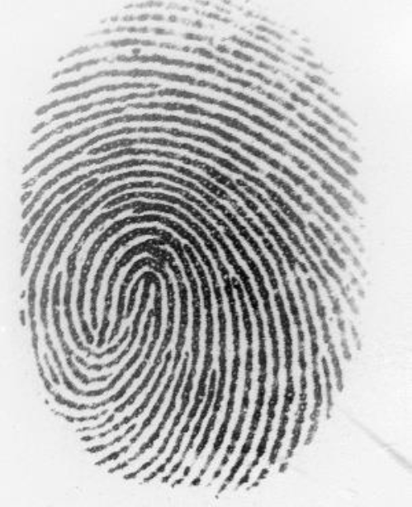
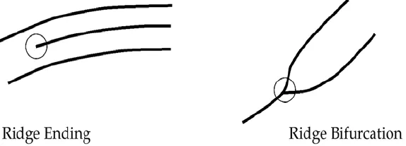
Fingerprint Identification system - Feature Extraction Algorithm
EEE-A-04
Electrical and Electronics Engineering
Students: Ofir Bar And Ariel Cohen
Advisor: Dr. Meir Yaakov
Introduction: Fingerprint recognition is a leading method for personal identification, based on minutiae (ridge endings and bifurcations). This process involves four key steps: capturing the fingerprint with a sensor, enhancing the image, extracting features, and matching them to entries in a database.
Objectives: Improve fingerprint image quality and extract key features such as ridge endings and bifurcations as reliable metrics for matching and identity verification.
ZK9500 Infra-red Scanner
Solutions Enabled by this Work: Enhances fingerprint recognition accuracy, strengthening biometric identification for security, law enforcement, travel, finance, healthcare, and access control.
Minutiae feature example
Fingerprint Sample

Slide 2
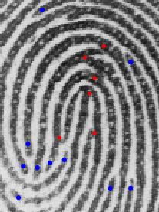
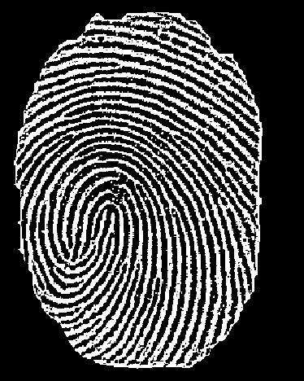
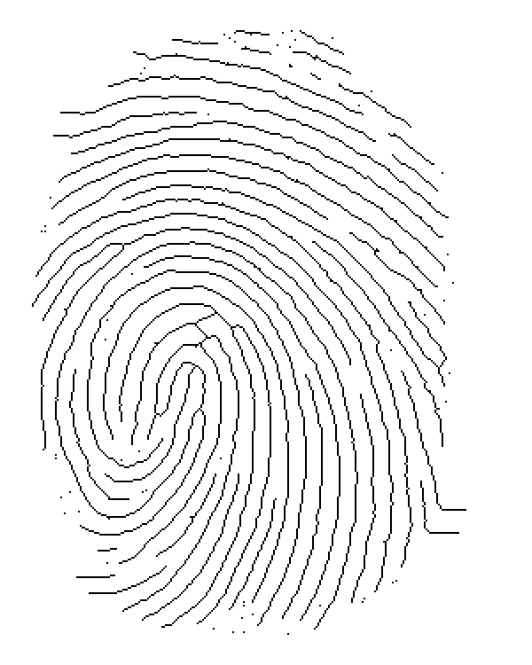
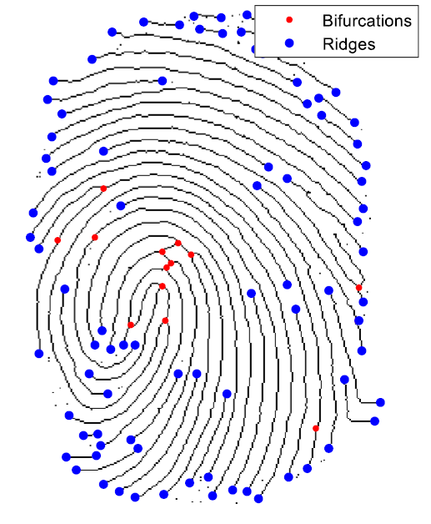
Fingerprint Identification system - Methodology main stages:
EEE-A-04
Electrical and Electronics Engineering
Students: Ofir Bar And Ariel Cohen
Advisor: Dr. Meir Yaakov
1. Preprocessing:
Loading the Image
Region Of Interest Extraction
Average Level Subtraction
Linear Contrast Stretch
Binarization Thresholding
2. Processing:
Removing Noise Pixels
Pruning Edges
Thinning Process
Removing Branches
Removing False Minutiae
3. Feature Detection
Using Convolution masks:
Detecting Bifurcations
Detecting Ridges
Detected Features on the original Sample
Preprocessing result
processing result
Detection result

Slide 3
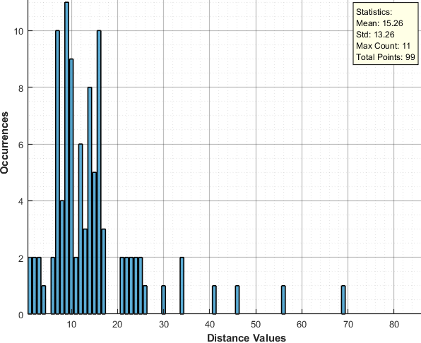
EEE-A-04
Electrical and Electronics Engineering
Students: Ofir Bar And Ariel Cohen
Advisor: Dr. Meir Yaakov
Fingerprint Identification system – Information extraction & Matching:
4. Feature Extraction
Applying ‘’Breadth First Search’’ algorithm to calculate the minimum distances between two neighboring Minutiae points.
Exporting table to CSV File as followed:
x | y | type | Distance ridges | Distance bifurcations | Distance combined
column | row | ridge/bifurcation | distance to nearest ridge | distance to nearest bifurcation | combined distance value
7. Conclusions:
Successfully developed a feature extraction algorithm using MATLAB with a true minutiae detection accuracy exceeding 95%. The extracted features were precisely converted into vectorized information, enabling effective use in both machine learning and deep learning-based matching systems.
5. Histogram Comparison – Proposed matching method
Organizing the distances vector as a histogram
Calculating Histogram Statistics
Comparing Histograms of different samples
Using histogram intersection percentage as the matching result
6. Future improvement:
Applying deep learning for sample matching

